Slide 1

Political Dynamics
Agencies responsible for the creation of ideologies
Pressure groups
Political parties
Media
Religion

Slide 2
Agencies responsible for creation and Propagation of Ideologies
Key agencies responsible for the creation and propagation of ideologies include: 1.Educational Institutions: Schools, colleges, and universities play a crucial role in shaping the beliefs and values of individuals. Curricula, teaching methods, and academic research can influence ideological development of the young and inexperienced minds. 2.Political Parties: Political parties create and promote ideologies to guide their policies and appeal the voters. They often craft narratives and platforms that reflect their ideological stances through their manifestoes and services. 3. Media (Print, Electronic and Social): Newspapers, television, radio, and digital media are powerful tools for spreading ideologies. Media outlets can shape public opinion by framing issues in specific ways, highlighting certain perspectives, and providing platforms for ideological debate.

Slide 3
4.Think Tanks and Research Institutes: These organizations conduct research and develop policy proposals based on specific ideological perspectives (right, left, center, religious, secular etc.). They often influence public policy and opinion through publications, conferences, and direct engagement with policymakers.
5.Religious Institutions: Churches, mosques, temples, and other religious organizations often propagate specific ideologies based on their religious doctrines. These institutions can influence moral and ethical perspectives in society.
6.Government and State Institutions: Governments can promote particular ideologies through policies, propaganda, and state-controlled media. Education and cultural ministries often play roles in shaping national ideologies.

Slide 4
7. Corporations and Business Groups: Large corporations and industry groups can influence ideologies through advertising, lobbying, and corporate social responsibility initiatives. They often promote economic ideologies that align with their interests and also many times influences government initiatives for public services.
8. Family and Community: Family structures and community organizations play a role in the early (in between the early years till 22 years) socialization of individuals- afterwards a person is expected to start becoming independent, transmitting beliefs, values, and ideologies from one generation to the next. These agencies interact in complex ways, often reinforcing or challenging each other's influence, contributing to the dynamic and multifaceted nature of ideological creation and dissemination in society.

Slide 5
PRESSURE GROUPS
The term pressure group is a very wide definition that does not clearly distinguish between the groups that fall under the term.
They can also be described as ‘interest groups’, ‘lobby groups’ or ‘protest groups’.
A pressure can be defined as follows;
A pressure group is a group of people who are organized actively for promoting and defending their common interest.
It is called so, as it attempts to bring a change in public policy by exerting pressure on the government.
It acts as a liaison between the government and its members.

Slide 6
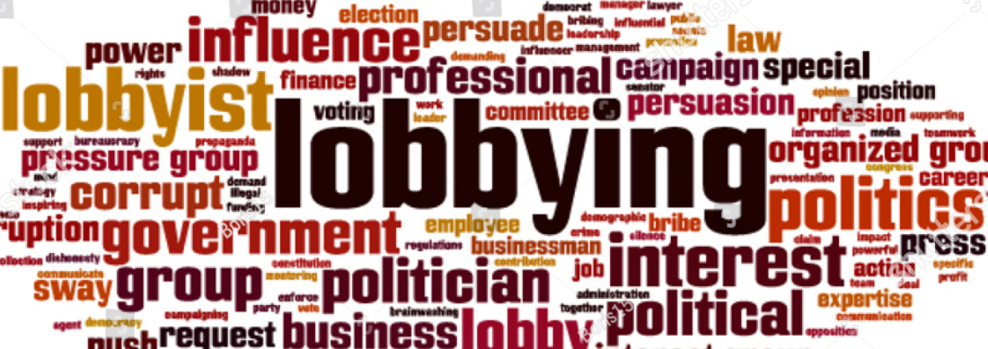
The pressure groups influence the policy-making and policy implementation in the government through legal and legitimate methods like lobbying, correspondence, publicity, propagandizing, petitioning, public debating, maintaining contacts with their legislators and so forth.

Slide 7
Characteristics of Pressure Groups
Based on Certain Interests: Each pressure group organizes itself keeping in view certain interests and thus tries to adopt the structure of power in the political systems.
Use of Modern as well as Traditional Means: They adopt techniques like financing of political parties, sponsoring their close candidates at the time of elections and keeping the bureaucracy also satisfied.
Inadequacies of Political Parties: Pressure groups are primarily a consequence of inadequacies of the political parties.

Slide 8
Types of Pressure Groups
Institutional Interest Groups: These groups are formally organized which consist of professionally employed persons. They are a part of government machinery and try to exert their influence.
These groups include political parties, legislatures, armies, bureaucracies, etc. Whenever such an association raises protest it does so by constitutional means and in accordance with the rules and regulations.
Associational Interest Groups : These are organized specialized groups formed for interest articulation, but to pursue limited goals.
These include trade unions, organizations of businessmen and industrialists and civic groups.

Slide 9
Anomic Interest Groups: By anomic pressure groups we mean more or less a spontaneous breakthrough into the political system from the society such as riots, demonstrations, assassinations and the like
Non-Associational Interest Groups: These are the kinship and lineage groups and ethnic, regional, status and class groups that articulate interests on the basis of individuals, family and religious heads.
These groups have informal structure.
These include caste groups, language groups, etc.

Slide 10
Role & Importance of Pressure Groups
Interest Articulation: Pressure Groups bring the demands and needs of the people to the notice of the decision-makers. The process by which the claims of the people get crystallized and articulated is called interest articulation.
Agents of Political Socialization: Pressure groups are agents of political socialization in so far as they influence the orientations of the people towards the political process.
These groups play a vital role as two-way communication links between the people and the government.
Pressure groups play a vital role in the legislative process, not only as important structures of interest articulation, but also as active agencies engaged in lobbying with the legislators for securing desired laws or amendments in laws and policies of the government

Slide 11
Pressure Groups and Administration: Pressure Groups are actively involved with the process of administration. Through lobbying with the bureaucracy, the pressure groups are usually in a position to influence the process of policy implementation.
Role in Judicial Administration: Pressure Groups try to use the judicial system for securing and safeguarding their interests.
Interest groups often seek access to the court to redress their grievances against the government as well as for getting declared a particular decision or policy as unconstitutional.

Slide 12
SHORTCOMING OF PRESSURE GROUPS
Misuse of power: Instead of the pressure groups exerting influence on political process, they become tools and implements to sub serve political interests.
Instability: Most pressure groups do not have autonomous existence; they are unstable and lack commitment, their loyalties shift with political situations which threatens general welfare. They many a times resort to unconstitutional means like violence.
Propagating extremism: Pressure groups can allow too much influence over the government from unelected extremist minority groups, which in turn could lead to unpopular consequences.

Slide 13
Conclusion
Pressure groups are now considered as an indispensable and helpful element of the democratic process.
The society has become highly complex and individuals cannot pursue their interests on their own.
They need the support of other fellow beings in order to gain greater bargaining power; this gives rise to pressure groups based on common interests.
Democratic politics has to be politics through consultation, through negotiation and some amount of bargaining is also involved.
Thus, it is very essential for the government to consult these organized groups at the time of policy formulation and implementation.

Slide 14
POLITICAL PARTIES
A political party is defined as an organized and presumably durable association, either of individuals or of distinguishable groups of individuals, which endeavors to place its members in governmental offices for the purpose of bringing about the adoption of favored political policies or programmes.
Of all the characteristics of parties, the one which distinguishes them from all other associations evincing a substantial interest in public affairs is their effort to secure the election or the appointment of their own personnel to the public positions through which the policies of government are prescribed for implementation.

Slide 15
Characteristics of a political party
One of the primary characteristics of a political party is its endeavor to control the exercise of governmental powers by placing its own members in the public offices through which the policies of government are determined.
Among these offices are those endowed with law-making authority and those invested with the power to direct and supervise the execution of laws.
A party strives to capture elective positions by placing its members in nomination and by campaigning for their election; in the case of appointive posts, its efforts are directed toward persuading the appointing authority to make selections from its membership.

Slide 16
2. A second characteristic of a political party is its intention to use governmental powers for purposes which meet with the general approval of its leaders and the rank and file of its membership.
Theoretically, the ultimate objective of a party is to secure adoption of its programmes for governmental action, whereas the placement of its members in key governmental positions is merely an essential means to this end.
3. Organization is another characteristic of political party. Organized effort is necessary to the attainment of both the immediate and the ultimate objectives of a party.
Without some sort of organization, parties stand little chance of winning control of the government and of directing its activities along desired lines.

Slide 17
4. An association may fall outside the “political parties” category even though the sole reason for its existence is the exertion of influence in the field of government.
Examples are the many taxpayers‟ leagues and the League of Women Voters in the United States of America.
An association of this type may provide its members with information concerning governmental problems, conduct discussion groups, endorse the candidates of various persons for elective offices, take a definite stand on some or all of the issues of the day, and bring pressure to bear on public officials in behalf of some policy or some change in governmental practice.

Slide 18
functions of political parties
One of the most important functions of parties is to nominate candidates for elective public offices. Parties almost always can be depended upon to provide nominees for whatever positions are to be filled by popular vote.
Parties also assume the responsibility of giving continuous thought to governmental problems and of proposing ways of solving them.
A related service of parties is to enable people who are in general agreement concerning desirable public policy to work together effectively to bring about adoption of the programme which they favor.
Another function of parties is to provide the people with information concerning public affairs, candidates, and the particular issues involved in elections.
Parties perform various helpful services for individuals and for groups. They keep the government informed as to what the people in general desire.

Slide 19
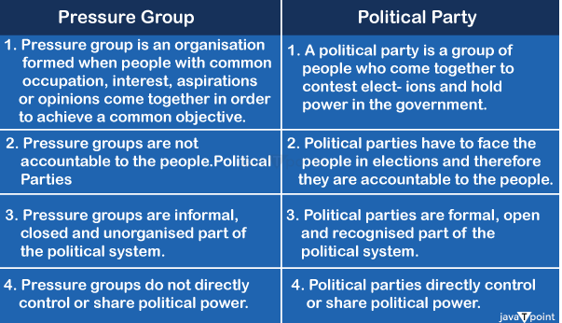
DIFFERENCE BETWEEN PRESSURE GROUP AND POLIT CAL PARTY

Slide 20
ROLE OF MEDIA
Media refers to various means of communication that help in communicating to a large number of people at the same time.
Among the different types of media includes mainstream media e.g., the newspaper or the press, the Radio, and the television.
The main function of the media is to inform the people about the current social, political and economic issues and to form and express strong conscious public opinion.
With the advancement of technology, the role and importance of mass media in shaping people’s attitudes, thoughts are increasing.
What role the media will play in a country depends on
I) the nature of the state system,
ii) how much people enjoy freedom in that state, and
iii) how the ruling class uses the media to build public consent or legitimacy

Slide 21
Media as a Means for the Formation of Public Opinion
As an instrument for the formation of public opinion, the press or the newspaper publishes the complaints of the people and the details of various problems of the society.
Newspapers interpret news, provide information on peoples hopes, aspiration and grievances, describe and critique government policies, analyze political event into a particular view point
Articles and editorial comments of the newspaper have a profound effect on the people and greatly influence their views.

Slide 22
Radio and television are also one of the most powerful means of influencing public opinion.
They affect everyone, educated and uneducated. People in remote rural areas also get various news of the country through them.
Radio and television help to form public opinion through its news coverage, review and survey.
But in many cases the government has control over radio and television.
As a result, there is no antigovernment discussion.

Slide 23
Media & Politics: Theoretical Perspective
According to liberal thinkers’ media are recognized as the fourth pillar of democracy.
On the one hand media provides information to the people on various issues, it also protects the people from abuse of power by criticizing government work.
In this way the media plays the role of watchdog.
On the other hand, Marxist theorists see the media as a part of a superstructure closely linked to the economic base the independent positions of the media are denied here.
. Marxist theorists Ralph Miliband said the editors and the journalists in newspaper and other media organization depend on the owners for their jobs and therefore will not use any apparent autonomy they may have to resist the dissemination of bourgeois’ ideology.

Slide 24
Media and Politics: Critical Appraisal
1. The government use the media to establish the legitimacy of the existing political system.
Various strategies are used to build the consent of the people. One of them is political advertisement.
In this case the qualities of a political party or leadership are unilaterally expressed.
Also, the demand of the people is given priority by making the advertisement attractive through languages, symbols and images.
The purpose of such advertisement to make profit, to entertain the listener, viewer or reader and to collect revenues

Slide 25
2. Another important role of the news media is in the field of election surveys.
The purpose of media polling during the election campaign is to draw the attention of the voters to the candidates and to introduce the issues, which is good for democracy or exception may occur.
The role of the media is also increasing in the case of exit polls.
However, the question remains about its accuracy, especially in large countries.

Slide 26
Conclusion:
As recognized as the independent position of the media, the role of the media as a tool for building the legitimacy of politicians or rulers is undeniable.
Although the extent of the media’s influence on political views and preferences is not accurately measurable, it is not possible to separate it from political life, rather it is growing.

Slide 27
DEFINING RELIGION
Religion is a “unified system of beliefs and practices related to sacred things, that is to say, things set apart and forbidden – beliefs and practices which unite people into one single moral community.”
According to A.W. GREEN,
“Religion is a system of belief and symbolic practices and objects governed by faith rather than by knowledge, which relates man to an unseen supernatural realm beyond the known and beyond the controllable.”

Slide 28
FUNCTIONS OF RELIGIOUS INSTITUTION in society
Religion Creates Social Solidarity: Religion is considered as a ‘Societal Glue’, as it creates harmony of attitude, ideas and habits among its followers.
They come closer to one another and are cemented together.
Religious rituals like weddings, births, burials and celebration of special religious events promote group solidarity and cohesion as all members know how to behave towards one another .

Slide 29
Socialization: As a process of initiation into the larger society, religion is an actual agent of socialization. In this case, parental faith, or religion becomes the faith of children.
E.g.: Religion teaches its followers to accept even negative life experiences, and their fate as something that is divinely predestined.
Social Control: Besides acting as an integrating force, religion also provides guidance and becomes a means of social control.
It provides rules and standards of behavior.
It also provides fear of divine punishment for those who do not abide by the rules, hence creating physical and social cleanliness.

Slide 30
Religious beliefs can influence the conduct of those who believe in them.
It keeps people ‘in line’ through folkways and mores.
Religious sanctions play a significant role in this regard.
Many taboos in various cultures have religious sanctions, e.g., the taboo against eating of pork in Jewish and Muslims and cows meat in Hindus.
Judgment of Right and Wrong: It helps to determine what is considered acceptable behavior and what is not. e.g. Islam divides actions into two categories; the right acts lead to Heaven and the wrong acts to Hell.

Slide 31
Role religion in politics of Pakistan
We should first understand that Pakistan is a country that was based on Islamic identity but was not created as a theocratic state, nor as a state that was meant to be exclusively for Muslims, to the exclusion of other religious groups.
It was really a state that was established to protect the religious, cultural and historical identity of the Muslims of the subcontinent when the British withdrew from South Asia.
Later, Zulifqar Ali Bhutto raised the slogan of Islamic socialism to appeal to both the socialist-leaning masses and the religious sentiments of the Pakistani people.
He also implemented policies such as declaring Friday a holiday, banning alcohol and gambling, and betting on horse racing.

Slide 32
In the name of Islam and with the support of various ulama, the Zia regime attempted to establish something very close to a theocratic state.
It did so not only to perpetuate itself in power but also to pave the way for vested interests to exploit the masses in the name of religion.
General Zia justified his continuation in power by claiming a divine mission to Islamize Pakistan and impose Islamic law under the banner of Nizam-e-Mustafa.

Slide 33
Imran Khan used religion during his term to mobilize the masses and appeal to their religious sentiments through religious rhetoric and populist tactics. In several speeches, he called for the formation of a “Riyasat-Madina.”
The establishment of the National Rahmatull-lil-Alameen (NRA) authority has become the center of critical debate in intellectual circles in Pakistan.
Imran Khan took the initiative to materialize his religio-political narrative.
He mainstreamed madrassas and reprioritized Islamic education through the single national curriculum.

Slide 34
THANK YOU

